Slide 1

Corporate law and economics (LL4489V/5489V/6489V) 12. minority shareholder protection
LL4489V
Kenneth Khoo
kenneth.khoo@nus.edu.sg

Slide 2

Minority shareholder protection
General Principles
Overview
Incomplete Contracting, Revisited
Theoretical/Conceptual Foundations
Empirical Evidence

Slide 3
General principles: overview
At a very fundamental level, the tension between shareholders is one that involves the balancing of:
The benefits and costs associated with vesting majority shareholders (or majority coalitions of shareholders) with relatively more power and…
The benefits and costs associated with vesting minority shareholders (or minority coalitions of shareholders) with relatively more power.
In general, the majority shareholders will be able to use their powers (note: this assumes that such powers are delegated to the shareholders as a whole and not the board) to act opportunistically against the minority shareholders.
However, if corporate law were to vest minority shareholders with too much power, they might also act opportunistically against the majority shareholders.
Tjio (2017): “It is sometimes not immediately obvious who is the oppressor and who the oppressed… Oppression at an extreme allows anything seemingly unfair to be pleaded, and the actions are ‘notoriously costly’... [If a buyout occurs], the cost of the oppression action could have affected shareholders so much that they do not have funds to inject into the company subsequently, such as through a rights issue.”

Slide 4
General principles: overview
Recall: In earlier Slides, we discussed the notion that the corporate “contract” is one which is associated with extremely “incomplete” terms, which had to be “gap-filled” ex post.
Unlike spot contracts, most issues in corporate law and governance are decided ex post many years after the corporation was first incorporated.
In principle, “gap-filling” could take place via the allocation of decision rights to managers/the board of directors, courts/regulators, or other parties.
However, gap-filling may also be conducted through the mechanism of collective decision-making amongst the shareholders, when decision-making powers are vested in the shareholders as a whole (as opposed to the board).
In earlier Slides, we learnt how one such mechanism relates to voting, where individual shareholder preferences are aggregated to represent a collective decision.
When the “general meeting” of a company passes a shareholders’ resolution, the voting outcome from the meeting is an aggregated representation of the collective decision of the shareholders as a whole.
Notes:
Provide some examples as to how “gap-filling” can take place via the courts?

Slide 5
General principles: overview
To the extent where contracting is complete, shareholders may be able to regulate their relationships inter se through:
The corporate charter/constitution/articles of association, or
Shareholder agreements
For instance, shareholders may insist on the inclusion of various clauses in a corporate constitution to protect their investments from opportunism.
Q: Why is ex-ante contracting a much better tool to govern inter-shareholder opportunism as opposed to the use of ex-ante contracting to control board (i.e., directorial) opportunism?
Hint: Consider the typical legal position of a corporate charter/constitution. In Singapore, s 39(1) of the Companies Act provides that “Subject to this Act, the constitution of a company, when registered, binds the company and the members thereof to the same extent as if it respectively had been signed and sealed by each member and contained covenants on the part of each member to observe all the provisions of the constitution.”
How would a corporate charter/constitution constrain directorial acts instead? What are the limitations of this approach?
Notes:
FD issues.

Slide 6

General principles: overview
For instance, shareholders may insist on the inclusion of various clauses in a corporate constitution to protect their investments from inter-shareholder opportunism. Examples of such clauses:
Appointment rights concerning board members. A shareholder agreement/constitution provision might “reserve” a number of board seats for a given shareholder.
Veto rights concerning the exercise of certain management powers by the board or to the shareholders (where delegated – see s 157(2) CA).
Veto rights concerning the amendment of the corporate charter/constitution.
Share restriction transfers, such as pre-emption rights (see Slide Deck 6).
The “issue space” concerning these rights is quite different from the same concerning tensions between the company’s board and its shareholder, as most of the company’s management powers would ordinarily lie with the board of directors.
In other words, inter-shareholder opportunism has a distinct nature from that of director-shareholder opportunism.
Notes:
Why would management powers lie with the board?

Slide 7
General principles: overview
As most of the management powers in a typical corporation will reside in the board, the scope for inter-shareholder opportunism is reduced when the board has substantial control of the company.
Indeed, this was the central argument of Blair and Stout (1999), where the removal of shareholder powers was seen to be normatively desirable in a setting of “team production”.
The problem is further attenuated with the presence of an independent board which does not answer to any particular shareholder. Hansmann (1979) has argued that this is the motivating premise behind the organization of non-profits.
However, inter-shareholder opportunism may be implemented through the board of directors. In this situation, the assumption of an independent board is no longer tenable.
This type of opportunism is particularly problematic when controlling shareholders dominate the corporate governance landscape, like in jurisdictions such as Singapore.
In other jurisdictions where controlling shareholders are absent, inter-shareholder opportunism is still salient so long as a substantial coalition of shareholders may collectively exercise their powers against a minority shareholder’s interests.

Slide 8
General principles: overview
Recall Slide 6 where we discussed how the “issue-space” in relation to inter-shareholder conflicts was quite distinct from the same relating to shareholders and directors.
When a controlling shareholder is present, the “issue space” is greatly expanded, and will also cover issues that are relevant to the shareholder-director conflict. Why?
Hint: What is the “dominant” right of shareholders which allows them to constrain directorial opportunism?
Thus, much of the literature in this area concerns the incentives and motivations of controlling shareholders.
NB: There can be different types of controlling shareholders (Family-owned controlling shareholders, State-owned controlling shareholders, etc.).
A controlling shareholder owns >50% of the shares of a given company, and thus effectively controls both organs of the company.
Q: Is director-shareholder opportunism still a salient feature in controlling-shareholder dominated jurisdictions? Why, or why not?

Slide 9
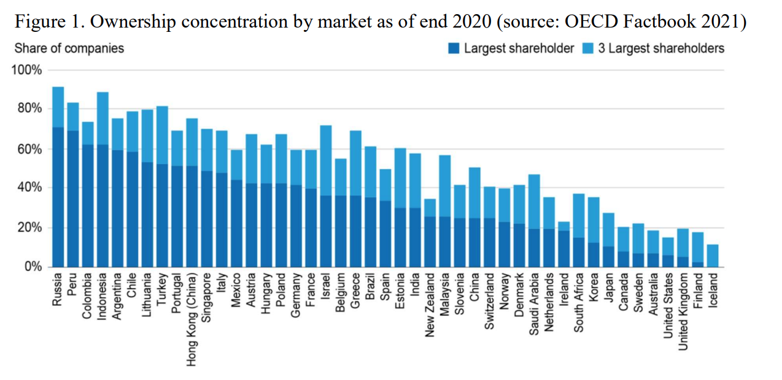
General principles: overview
Given that the likelihood of opportunism among shareholders largely depends on ownership structures, we should examine how shareholding is organized globally today.
Despite their “outsized” dominance in the corporate governance scholarship, most jurisdictions other than the U.S. and UK are dominated by controlling shareholders.
Davis and Pargendler, 2023

Slide 10
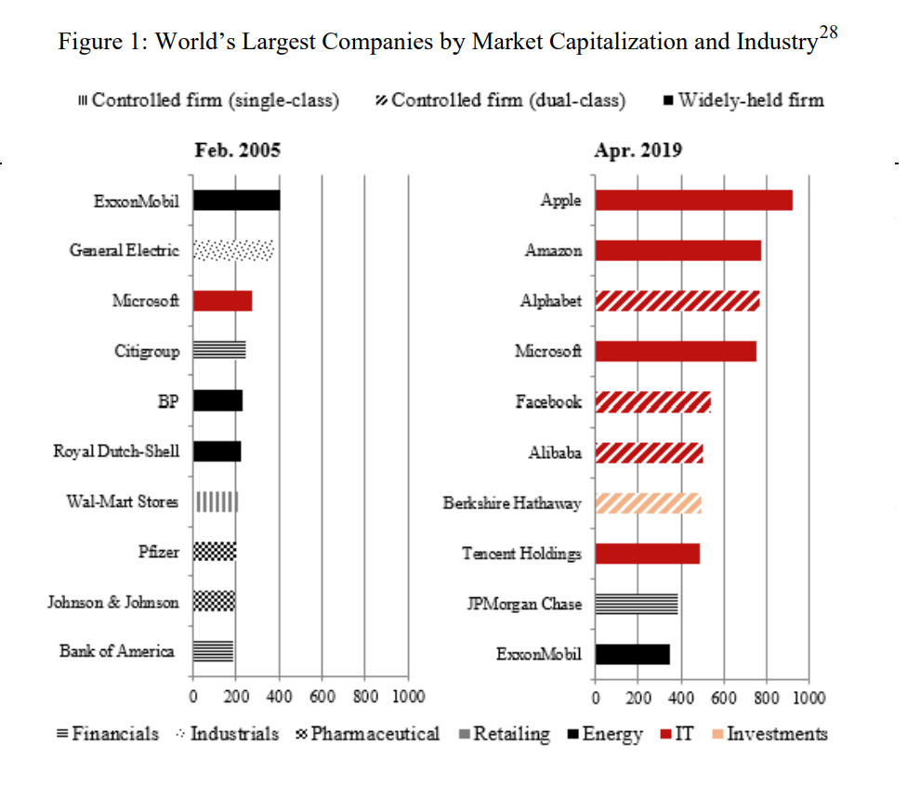
General principles: overview
Furthermore, even in the U.S. (which has an ostensibly “diffuse” ownership structure), many of the largest companies are now owned by controlling shareholders.
Pargendler (2020): “While the largest companies of yesterday mostly had dispersed ownership structures, they now frequently boast controlling shareholders. In fact, these are often controlling minority shareholders through the use of dual-class structures, which amplify agency costs. As portrayed in [the Figure], the list of the world’s largest firms by market capitalization in 2005 included only one tech company (Microsoft) and one controlled company under a single-class structure (Walmart). By 2019, seven of the world’s largest firms were in the tech sector (Apple, Amazon, Alphabet, Microsoft, Facebook, Alibaba, and Tencent Holdings) and four were controlled companies with dual-class shares (Alphabet, Facebook, Alibaba, and Berkshire Hathaway). Moreover, Amazon is a borderline case, with founder Jeff Bezos holding a sizable equity stake and outsize influence in the company…”

Slide 11
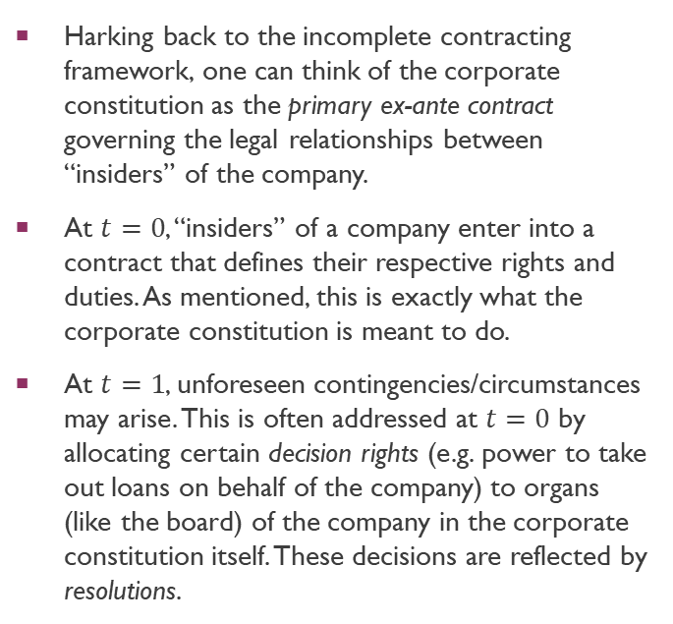
General principles: incomplete contracting, revisited
Corporate Constitution
Harking back to the incomplete contracting framework, one can think of the corporate constitution as the primary ex-ante contract governing the legal relationships between “insiders” of the company.
At $t=0$, “insiders” of a company enter into a contract that defines their respective rights and duties. As mentioned, this is exactly what the corporate constitution is meant to do.
At $t=1$, unforeseen contingencies/circumstances may arise. This is often addressed at $t=0$ by allocating certain decision rights (e.g. power to take out loans on behalf of the company) to organs (like the board) of the company in the corporate constitution itself. These decisions are reflected by resolutions.
Ex Post “Gap Filling” via allocation of decision rights
Ex Ante Contract
time
0
1

Slide 12
General principles: incomplete contracting, revisited
Corporate Constitution
What happens if decision-rights are allocated to a majority (controlling) shareholder or a board of directors controlled by the majority shareholder?
Then the majority shareholder has the incentive to exploit the minority shareholders by using these decision-rights for their own benefit at the minority shareholders’ expense, increasing shareholder-shareholder opportunity.
But vesting veto rights in minority shareholders gives rise to holdout problems.
Implying terms via contract law (litigation) may be exceedingly costly.
Ex Post “Gap Filling” via allocation of decision rights
Ex Ante Contract
time
0
1

Slide 13
General principles: incomplete contracting, revisited
One way of thinking about how majority shareholders (either controlling shareholders or majority coalitions of concentrated shareholders) may “oppress” the minority is to think about how voting pathologies might result when the majority and minority shareholders turn out to vote.
Consider an “issue” regarding how much the firm should spend on R&D.
No “correct” answer to the Q, as amount spent on R&D might well have superior uses depending on the risk preferences and time-preferences (i.e., whether the shareholder is “long-term” or “short-term”) of the shareholder.
Will C ever have a “say” in a majority vote on the decision? How does this differ from elections in polities?
A and B can vote to have the org choose this point
Amount spent on R&D
A
B
C

Slide 14
General principles: incomplete contracting, revisited
Amount spent on CEO compensation
A and B can vote to have the org choose this point
B
A
C
Amount spent on R&D
Notes:
Distance that would be fair to all shareholders would be the median point. However, any point in the shaded region would be better for C.

Slide 15
Theoretical and conceptual foundations
Now that we have some rough idea as to the general principles that ought to illuminate our analysis, we will turn to the central features of the L&E of minority shareholder protection.
In general, most of the literature focuses on two main issues:
The first issue concerns how corporate law should regulate the conduct of controlling shareholders.
As we will discover, the issue is involved because the presence of a controlling shareholder is associated with both costs and benefits.
The second issue concerns how corporate law should regulate the decision space when the decision falls within the powers of the shareholders as a whole.
Unlike the board of directors, the aggregation of preferences across multiple shareholders is non-trivial due to the pathologies of collective decision-making.
Some of these pathologies involve problems which arise when minority shareholders are given too much power.
We will discuss some of the costs and benefits associated with voting, elections, and why similar issues do not plague the board of directors.
NB: We will discuss both issues concurrently.
Notes:
Holdout problems.

Slide 16
Theoretical and conceptual foundations
Gilson and Gordon (2003): “The presence of a large shareholder may better police management than the standard panoply of market oriented techniques. The second is the agency problem that arises between controlling and non-controlling shareholders, which produces the potential for private benefits of control-benefits to the controlling shareholder not provided to the non-controlling shareholders. There is, however, a point of tangency between these facets. Because there are costs associated with holding a concentrated position and with exercising the monitoring function, some private benefits of control may be necessary to induce a party to play that role. Thus, from the public shareholders' point of view, the two facets of the agency problem present a tradeoff. The presence of a controlling shareholder reduces the managerial agency problem, but at the cost of the private benefits agency problem. Non-controlling shareholders will prefer the presence of a controlling shareholder so long as the benefits from reduction in managerial agency costs are greater than the costs of private benefits of control.”
What are the “private benefits of control” that Gilson and Gordon are referring to?
See Slide Deck 11 in relation to Director Primacy: “[A form of] psychic/other benefit that, without more, involve no transfer of real company resources… [and do not] dilute the value of the company’s stock to a diversified investor. For example, control of a large company in a small economy may provide a desirable social status for the controlling family.”
Q: What about transfers of wealth? Are Gilson and Gordon referring to transfers of company resources when they discuss the notion of private benefits of control?
Notes:
Provide some examples as to how “gap-filling” can take place via the courts.

Slide 17
Theoretical and conceptual foundations
Gilson and Gordon (2003) [regarding transfers of wealth]: “[Following Sinclair Oil Corp v Levien], core self-dealing is held to a dramatically different standard. If the controlling shareholder appears to benefit at the expense of the controlled corporation (for example, when the controller disparately gains from contract terms or the enforcement of those terms where the two parties are on opposite sides), the intrinsic fairness standard-the most rigorous in corporate law jurisprudence applies. In that situation, the controlling shareholder bears the burden of proving that the terms of the transaction were intrinsically fair, with the court making a de novo determination.”
Anabtawi and Stout (2008): “In Sinclair, the controlling parent corporation did not exploit the minority shareholders in its partially held subsidiary by arranging a freeze-out merger. Rather, it used its control over the subsidiary to benefit itself by causing the subsidiary to sell it petroleum products on favorable terms. Sinclair thus illustrates how, when presented with fact patterns that fall outside the standard freeze-out context but nevertheless raise clear conflict of interest issues, courts have responded by imposing loyalty duties on controlling shareholders.”
Does Gilson and Gordon’s argument (concerning transfers) appeal to you? Why, or why not?
NB: This “solution” is not the law in commonwealth jurisdictions, where shareholders face no such duty. See Lim (2018).
Notes:
Provide some examples as to how “gap-filling” can take place via the courts.

Slide 18
Theoretical and conceptual foundations
From an efficiency point of view, a mere transfer of wealth is not necessarily “inefficient” in an ordinal sense. Why?
Rent-seeking conduct meant to induce these transfers, however, is likely to induce inefficiency and ought to be discouraged.
Khoo (2022): “’Winners’ of a shareholder vote benefit from the involuntary transfers of the ex post mutual gains from trade from dissenting shareholders to themselves. Accordingly, rational shareholders may be willing to expend socially wasteful costs to obtain these rents ex post, even if it is not known ex ante whether they will be part of the winning coalition in a given shareholder vote. In a common example from the public choice literature, private firms may be willing to invest socially wasteful resources to increase the probability of obtaining a state-granted monopoly – beyond the efficiency losses created by the monopoly itself. Buchanan suggests that these rent-seeking expenditures could include the lobbying efforts and expenditures of these private firms, the efforts of the state to react or obtain the expenditures of the potential recipients, as well as third-party distortions created by the rent-seeking activities.”
Can you think of some examples in the setting of corporations?

Slide 19
Theoretical and conceptual foundations
Beyond rent-seeking conduct, one problem associated with inter-shareholder opportunism relates to “hold-up problems”.
Hold-up problems are concerned with the reduction of relationship-specific investments which would be otherwise associated with greater firm profits (see Slide Deck 11 on r/s specific investments).
If these investments are reduced or removed, would the company’s value be affected?
Khoo (2022): “Under a majority rule, minority shareholders are potentially exposed to ex post opportunism by majority shareholders. In particular, the voting rule grants majority shareholders residual rights of control over the issue put up for a vote, allowing majority shareholders to induce involuntary transfers of the ex post mutual gains from trade from minority shareholders to themselves… such losses will arise where shareholders may engage in relationship-specific investments that increase firm-value... Anticipating the possibility of these involuntary transfers, dissenting shareholders may reduce these specific investments at the outset of the relationship so as to limit the potential for these ex post losses. Indeed, the incentives faced by dissenting shareholders are exceedingly similar to the incentives of non-owners in [Grossman and Hart (1983)] – non-owners of a firm face incentives to decrease their ex-ante investments in the firm where the firm’s owner has residual rights of control and is thus able to interpret the contract to her advantage ex post.”

Slide 20
Theoretical and conceptual foundations
Furthermore, as per the political science literature, it is possible that the collective preferences of shareholders are simply undefined, leading to problems of indeterminacy.
What does this mean? Simply put, shareholders might have individual preferences over issues, but there is no “meaningful” way to aggregate these preferences so that the shareholders “as a whole” can collectively speak with one voice!
Khoo (2022): “Consider a scenario where three shareholders have to vote on three different alternatives, X, Y, and Z – corresponding to three candidates running for the corporation’s CEO position. Shareholder A prefers candidate X to Y, Y to Z, and X to Z. Meanwhile, shareholder B prefers X to Y, Z to Y, and Z to X. Finally, shareholder C prefers candidate Y to X, Y to Z, and Z to X. If shareholders are asked to engage in a pairwise voting of directors under the majority rule, an endless cycle results. For instance, for an election pitting X against Y, shareholders A and B would vote for X – ostensibly rendering X the winner. However, in a contest between X and Z, shareholders B and C would vote for Z, rendering Z the winner. But in a contest between Z and Y, shareholders A and C would vote for Y, rendering Y the winner instead. Under the majority rule, no winner can be selected non-arbitrarily.”
Why is this problem far less unlikely to plague the board of directors? How do directors make decisions at the board-level?

Slide 21
Theoretical and conceptual foundations
As a practical matter, what happens “in real life” when shareholders have such intransitive preferences?
McKelvy (1976): “an individual who can control the agenda of pairwise votes can lead the collective to any outcome in the issue space he chooses… Intuitively, an agenda-setter is able to exploit a voting cycle through continuous voting which “cycles” through all possible outcomes”.
Requisitioning meetings/turning up for shareholder meetings is costly, so outcome will likely be decided by either the board of directors (who may have agenda-setting powers) or shareholders who are able to expend resources to contest battles for control.
More on this in Topic on Shareholder Activism and Voting.
Q: What about the “free-riding” problem in corporate governance? How is this important for our analysis re inter-shareholder opportunism?

Slide 22
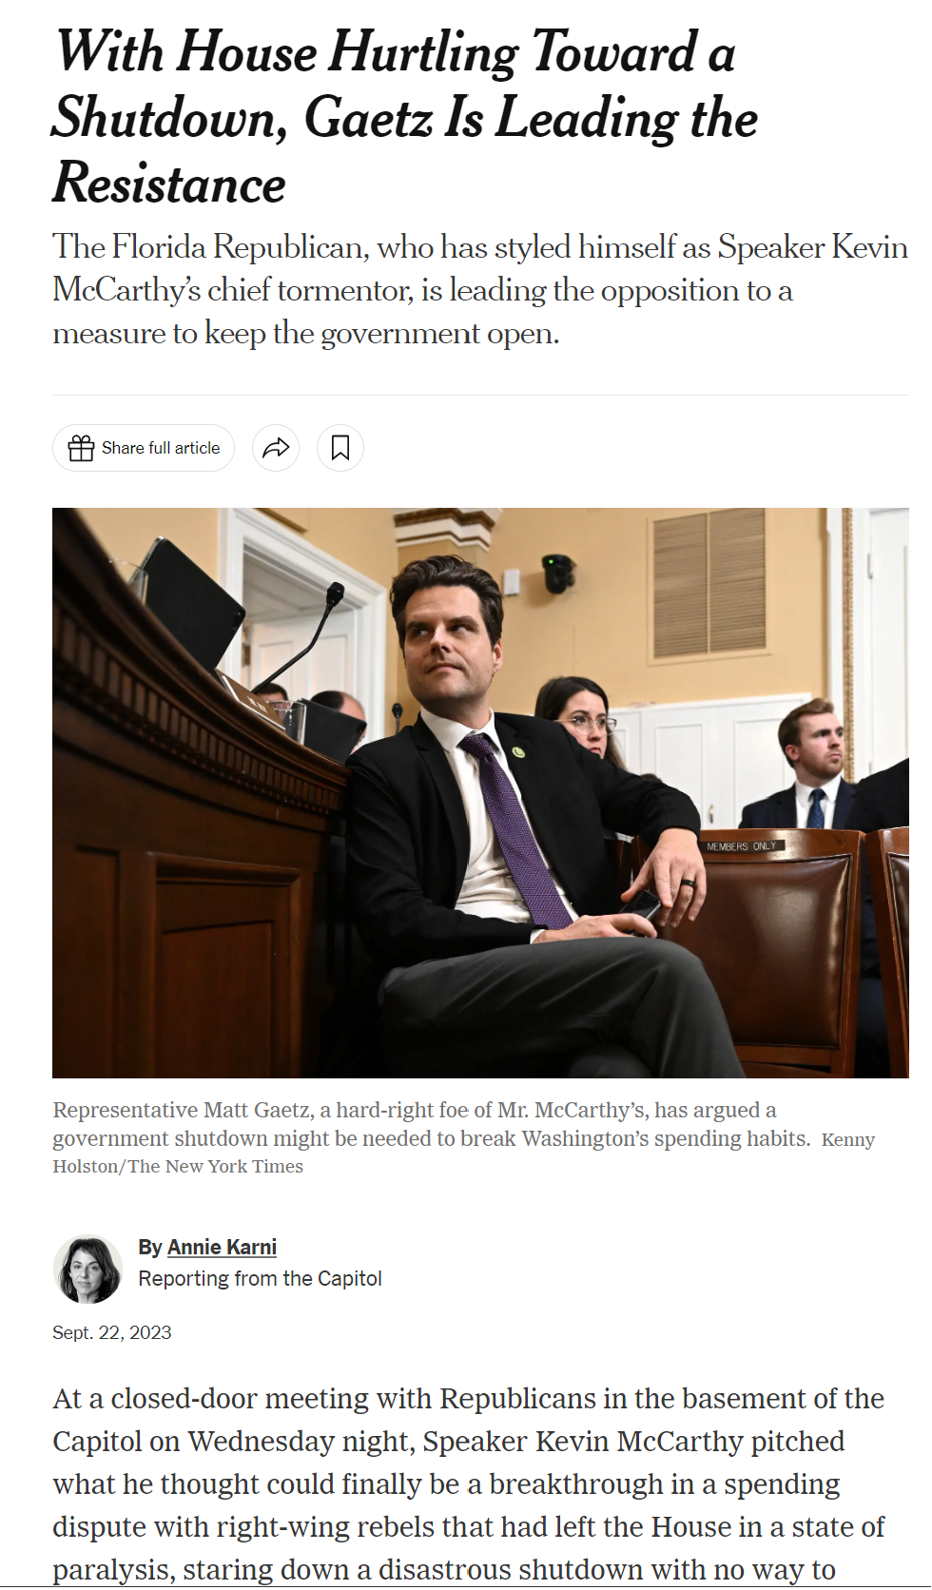
Theoretical and conceptual foundations
Beyond these issues, there are also concerns when individual shareholders are given too much power.
These problems are often known as “holdout” problems.
Khoo (2022): “Holdout problems are associated with an individual shareholder’s withholding of consent necessary to render a collective decision, subject to the condition that other shareholders accede to her demands – usually for a larger share of the ex-post economic wealth created by the collective decision.137 Crucially, the vote of the shareholder who is “holding out” must be necessary for the voting rule to pass. Without the vote of the holdout(s), the proposed vote will fail, precluding all of the cooperative gains from trade.”
Intuition: “Hostage-taking” behaviour pursuant to negotiations.
Often forms the implicit justification for majoritarian rule (see cases on amendments and/or procedural irregularities).

Slide 23
Theoretical and conceptual foundations
One mystery regarding jurisdictions (like Singapore) with controlling shareholders concerns why “good corporate governance” can exist there.
In older accounts (La Porta et al. 2000), “controlling shareholder regimes exist in jurisdictions whose legal systems do not protect minority shareholders from dominant shareholders' diversion of private benefits of control. As a result, a controlling shareholder who takes a company public will not part with control; if she does, someone else will purchase control in the market and exploit her.”
Problem: we observe controlling shareholder regimes in jurisdictions with good law, so law cannot completely explain the distribution (Roe, 2003).
Example: Singapore often ranks very highly in international rankings insofar as corporate governance is concerned.
Gordon (2006) argues that there are two very different kinds of controlling shareholders: efficient and inefficient. Thus, there are controlling shareholder regimes with “functionally bad law and regimes that have functionally good law [that] support a diversity of shareholder distributions”.

Slide 24
Theoretical and conceptual foundations
Gordon (2006): “A national pattern of concentrated control of publicly traded corporations can be consistent with two very different equilibria. First, the ownership pattern may reflect a structure of inefficient controlling shareholders, in which bad law allows the cost of private benefit extraction to exceed the benefits of more focused monitoring of management - minority shareholders are net worse off from the controlling shareholder's monitoring effort. Alternatively, the ownership pattern may reflect a structure of efficient controlling shareholders, in which good law helps the benefits of more focused monitoring exceed the costs of private benefit extraction - minority shareholders are net better off from the controlling shareholder's monitoring effort. From this perspective, an inefficient controlling shareholder regime is a drag on the financial system, while an efficient controlling shareholder regime can be a preferred alternative to market-based monitoring.”
Can we estimate the “price” of private benefit extraction?

Slide 25
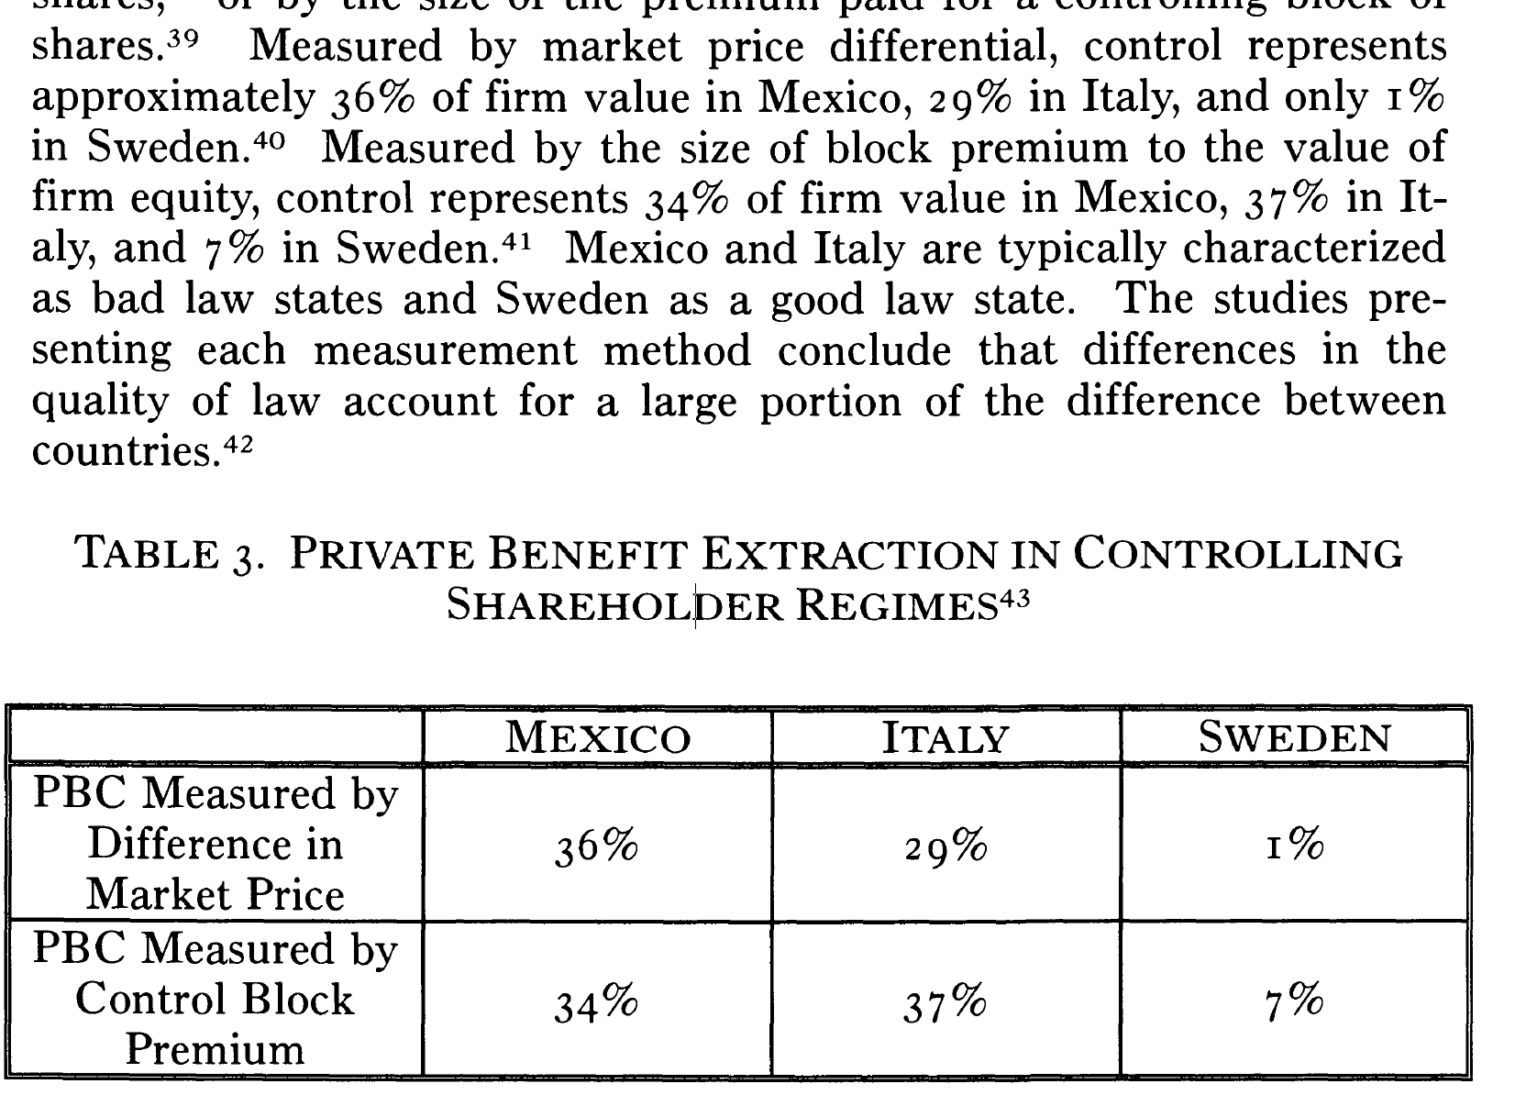
Theoretical and conceptual foundations

Slide 26
Theoretical and conceptual foundations
Gordon (2006): “Controlling for measures of productivity and all other governance characteristics, Professors Bernard Black, Hasung Jang, and Woochan Kim found that large firms with a majority of outside directors, as required by the change in South Korean law, experienced a 40% increase in stock price. Of particular significance, the increase in stock price did not result from increased firm productivity; companies did not become more productive because of the increase in the number of independent directors. Rather, the presence of a majority of outside directors appears to have caused the market to value more highly the company's existing cash flow. The authors interpret their results as showing the potential importance of outside directors - that is, functionally good law - in controlling private benefit extraction by controlling shareholders: "[Higher share prices] could be because outside directors may help to control self-dealing by insiders, which historically has been a serious problem in Korea.”
Gordon (2006): Controlling shareholders are essentially a substitute for alternative market mechanisms…
That being the case, “an efficient controlling shareholder system supports a diversity of shareholder distributions, including both companies with a controlling shareholder and companies with widely distributed shareholders, while an inefficient controlling shareholder system only supports companies with a controlling shareholder.”
Notes:
What are these “alternative market mechanisms”?

Slide 27
Theoretical and conceptual foundations
Why do shareholders disagree with each other? Shouldn’t they all be concerned about the [ultimate] pecuniary value of the corporation’s business?
Anabtawi (2006): That’s simply not the case. We observe tensions between:
Short-term vs Long-term shareholders
Diversified vs Undiversified shareholders
“Insider” vs “Outsider” shareholders
Public/Union Pension Funds vs Economic shareholders
Hedged vs Unhedged shareholders
Khoo (2023): With common ownership, entire premise of own-firm profit maximization falls apart. Shareholder heterogeneity is intrinsic to objective function of the firm.
Notes:
More on this in ownership structures.

Slide 28
Empirical evidence
Dyck and Zingales (2004): “In this paper we use the Barclay and Holderness (1989) method to infer the value of private benefits of control in a large (39) cross section of countries. Based on 393 control transactions between 1990 and 2000 we find that on average corporate control is worth 14 percent of the equity value of a firm, ranging from a -4 percent in Japan to a +65 percent in Brazil. Interestingly, the premium paid for control is higher when the buyer comes from a country that protects investors less (and thus is more willing or able to extract private benefits). This and other evidence suggest that our estimates capture the effect the institutional environment has on private benefits of control.”
“[The Barclay and Holderness method] focuses on privately negotiated transfers of controlling blocks in publicly traded companies. The price per share an acquirer pays for the controlling block reflects the cash flow benefits from his fractional ownership and the private benefits stemming from his controlling position in the firm. By contrast, the market price of a share after the change in control is announced reflects only the cash flow benefits noncontrolling shareholders expect to receive under the new management. Hence, as Barclay and Holderness have argued, the difference between the price per share paid by the acquiring party and the price per share prevailing on the market reflects the differential payoff accruing to the controlling shareholder. In fact, after an adjustment, this difference can be used as a measure of the private benefits of control accruing to the controlling shareholder.”

Slide 29
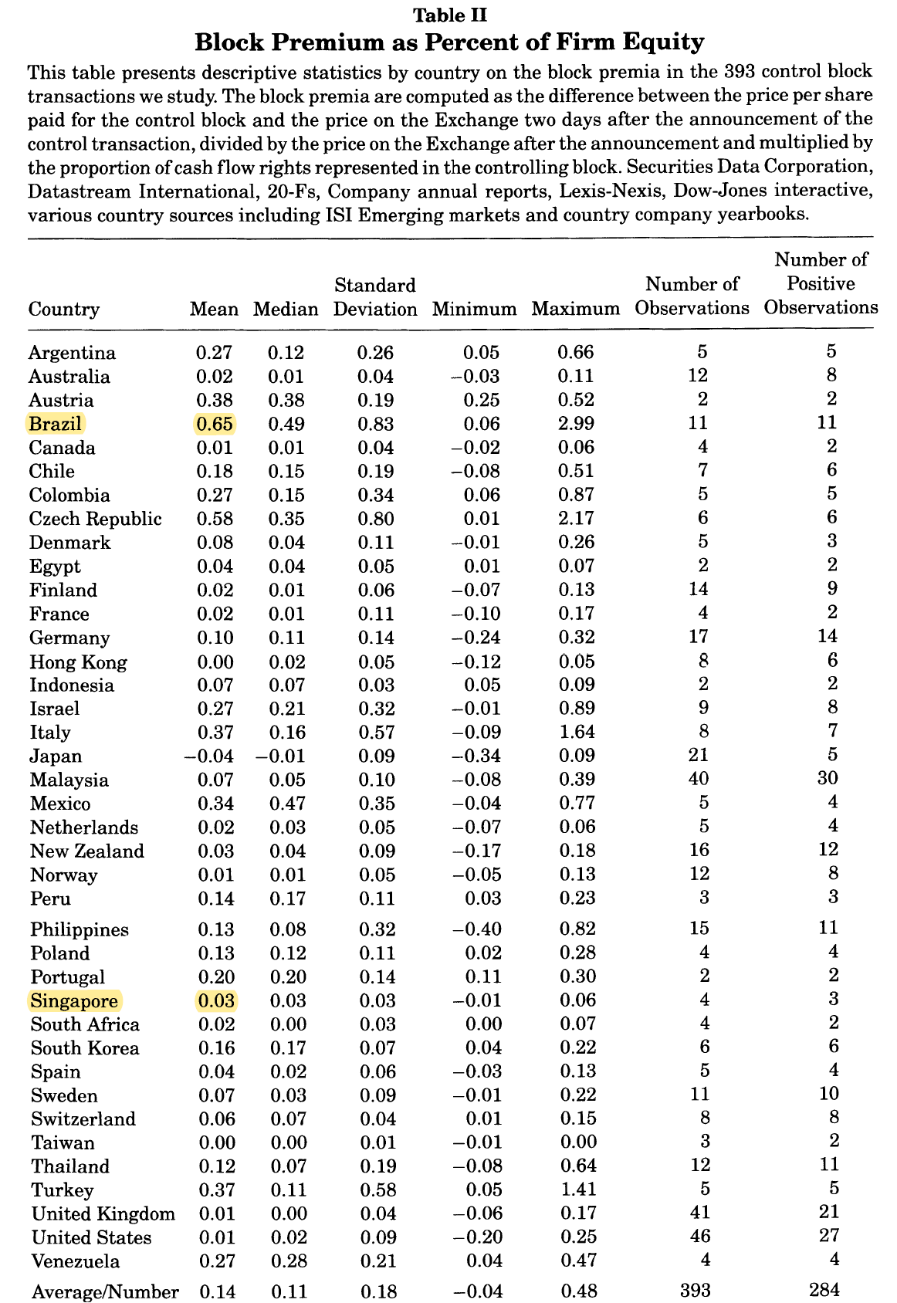
Empirical evidence

Slide 30
Empirical evidence
Bolton et al. (2020): “We estimate institutional investor preferences from proxy voting records. The W- NOMINATE method maps investors onto a left-right dimension based on votes for fiscal year 2012… The main finding of our estimation is that, just as legislators’ ideological differences in Congress can be represented along a left-right spectrum (Poole and Rosenthal, 1985 , 2007), institutional investors’ ideal points map onto a line, where the far-left investors are best described as socially responsible investors (those who vote most consistently in favor of pro-social and pro-environment shareholder proposals) and the far-right investors can be described as “money-conscious” investors (those who oppose proposals that could financially cost shareholders). In other words, the issue that most separates institutional investors is the degree to which they weigh social responsibility.”
“General equilibrium theory emphasizes the notion of shareholder unanimity under complete, competitive finan- cial markets ( Grossman and Stiglitz, 1977; Grossman and Hart, 1979). When markets are incomplete, Milton Friedman further argued that shareholders unanimously prefer value maximization because negative externalities are best addressed through public policy. Yet, a central finding of Matvos and Ostrovsky (2010) is that shareholders are far from unanimous. In their study of mutual fund voting in director elections, they find that voting behavior differs systematically in how supportive mutual funds are of management.

Slide 31
Empirical evidence
Bolton et al. (2020): “We also find that governance is a second dimension separating investors, with investors differing on how tight a discipline should be imposed on management... Also, the ideology of most pension funds is to the left, while that of the largest mutual funds is to the right, and the funds voting in line with the proxy advisor ISS recommendations are squarely in the center. The other main proxy advisor, Glass Lewis and the large index-funds Vanguard and BlackRock are center-right. Along the governance dimension, Glass Lewis and the pension funds tend to be more management-disciplinarian than most mutual funds. The more socially responsible large funds, such as Nuveen, PIMCO, DFA, and Grantham, Mayo, and Van Otterloo, are more management-friendly, while BlackRock, Vanguard, and GAMCO are both more profit-oriented and more management-disciplinarian.”

Slide 32
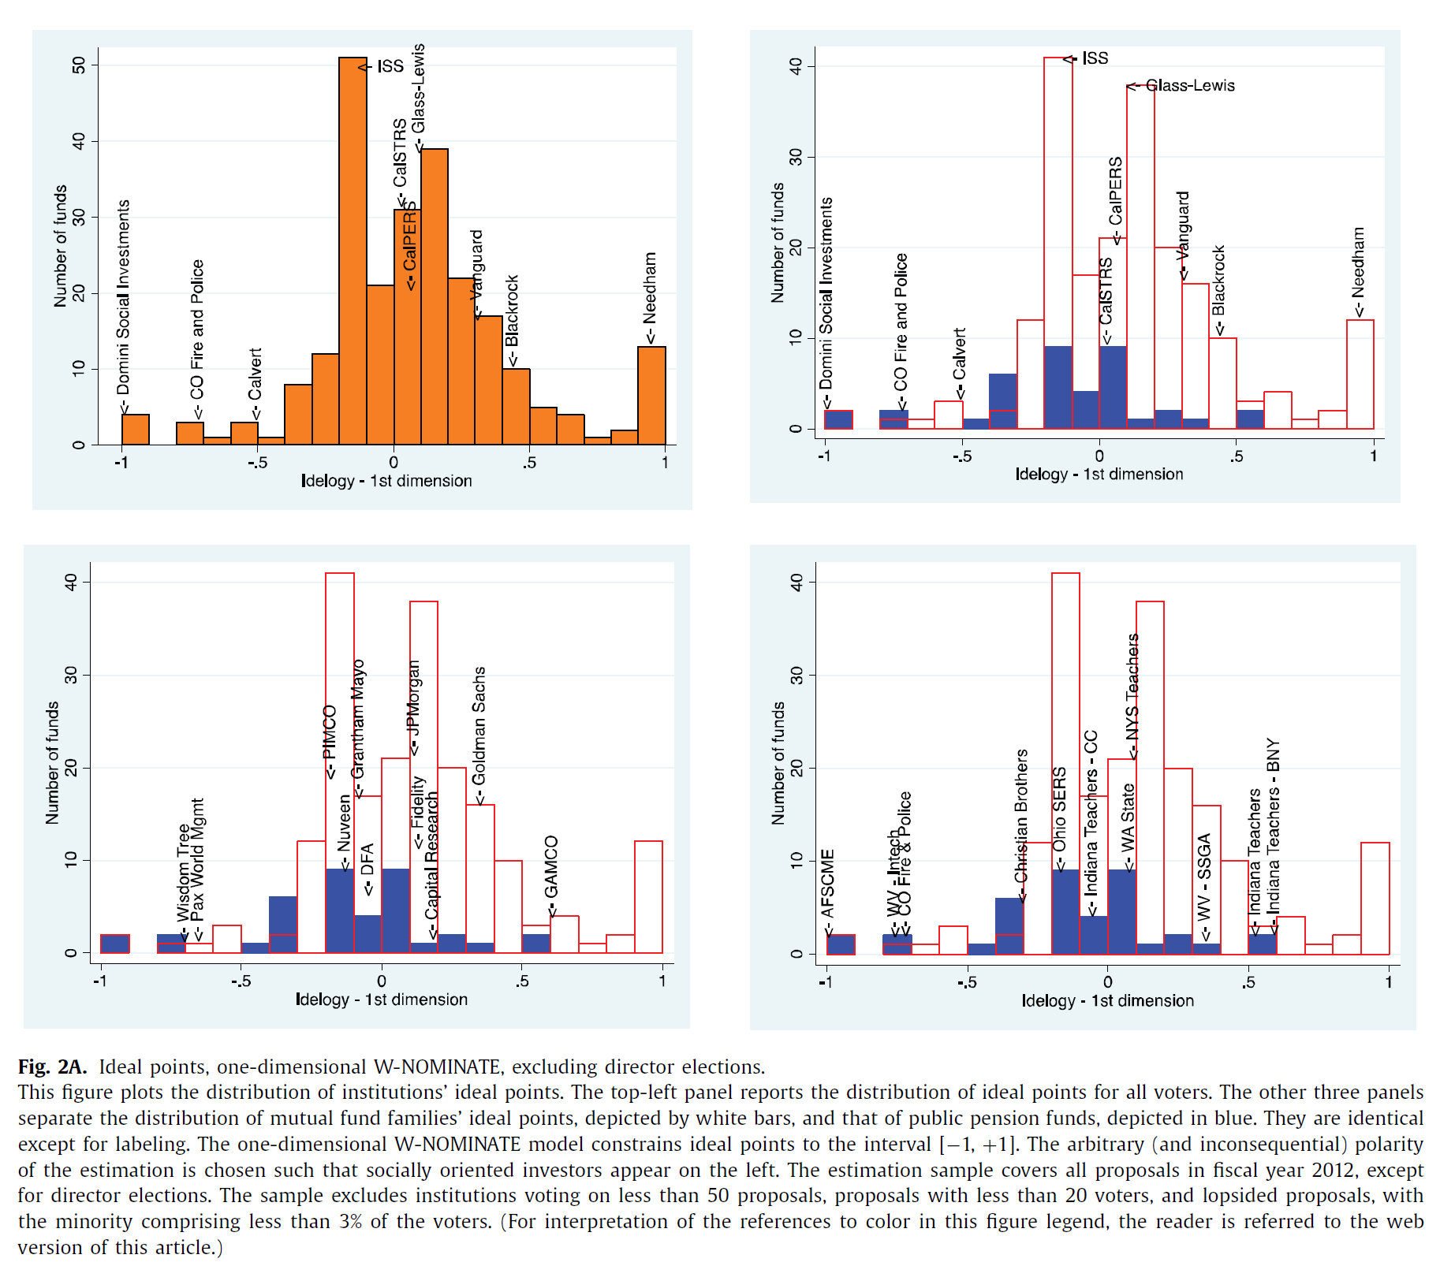
Empirical evidence

Slide 33
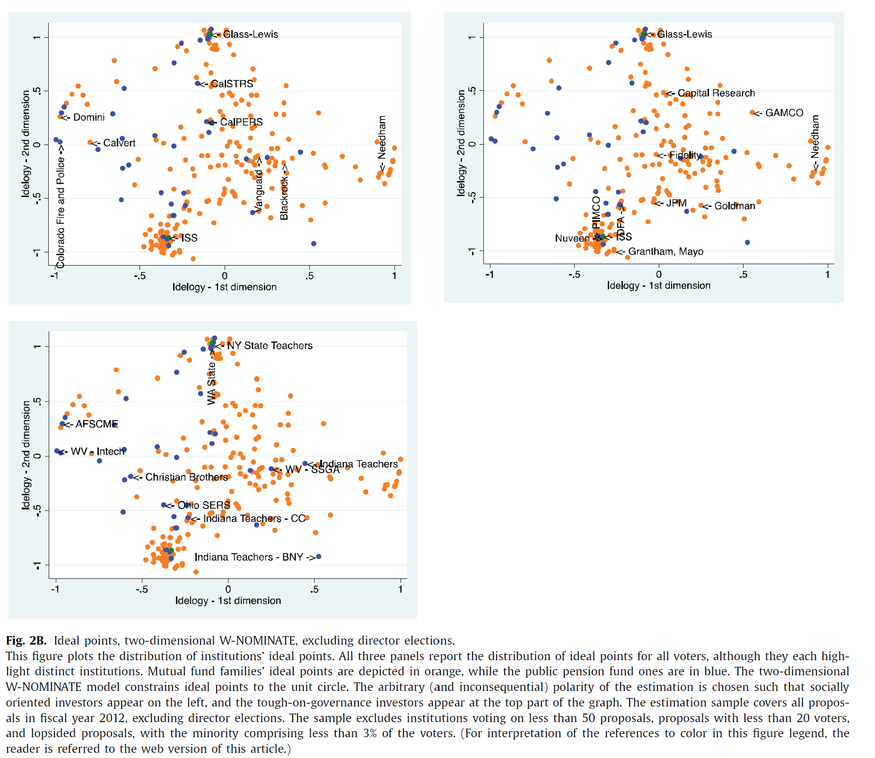
Empirical evidence

Slide 34
Empirical evidence
Bubb and Catan (2021): “We investigate the structure of mutual funds’ corporate governance preferences as revealed by how they vote their shares in portfolio companies. We apply unsupervised learning tools from the machine learning literature to analyze mutual funds’ votes and find that a parsimonious two-dimensional model can explain the bulk of mutual fund voting. The dimensions capture competing visions of corporate governance and are related to the leading proxy advisors’ recommendations.”
“In this paper we develop the first systematic account of the structure of mutual fund preferences over corporate governance. We focus on two basic questions. First, what are the main ways in which mutual funds differ in their corporate governance preferences, as reflected in how they vote? Second, given that variation in voting behavior, what are the characteristic “types” of mutual funds in terms of their corporate governance philosophies?”

Slide 35
Empirical evidence
Bubb and Catan (2021): “The first dimension of our estimated preference space primarily captures the tendency of funds to oppose (support) management when the leading proxy advisor, ISS, recommends against (in favor of) management but its main competitor, Glass Lewis, does not. It thus captures fund voting behavior for proposals on which the two proxy advisors disagree. In contrast, dimension 2 primarily captures funds’ tendency to vote against management when Glass Lewis recommends to do so, irrespective of ISS’s recommendations.”
“We use model-based cluster analysis to identify three main groups of mutual funds in terms of their preference scores. We conceptualize these groups as mutual fund “parties” and show that they are a fundamental feature of mutual fund voting.”

Slide 36
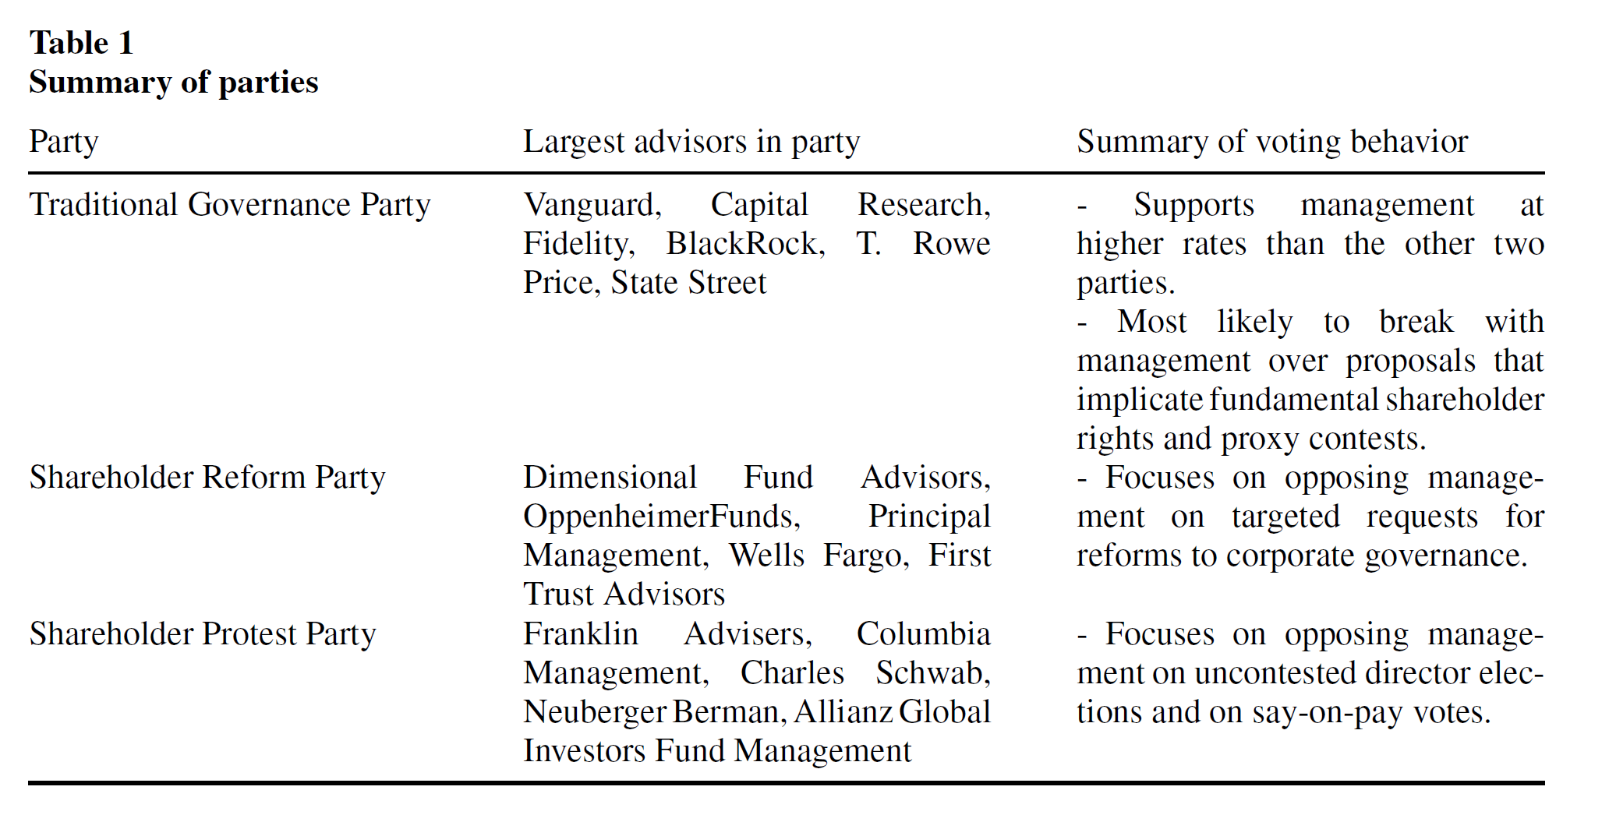
Empirical evidence

Slide 37
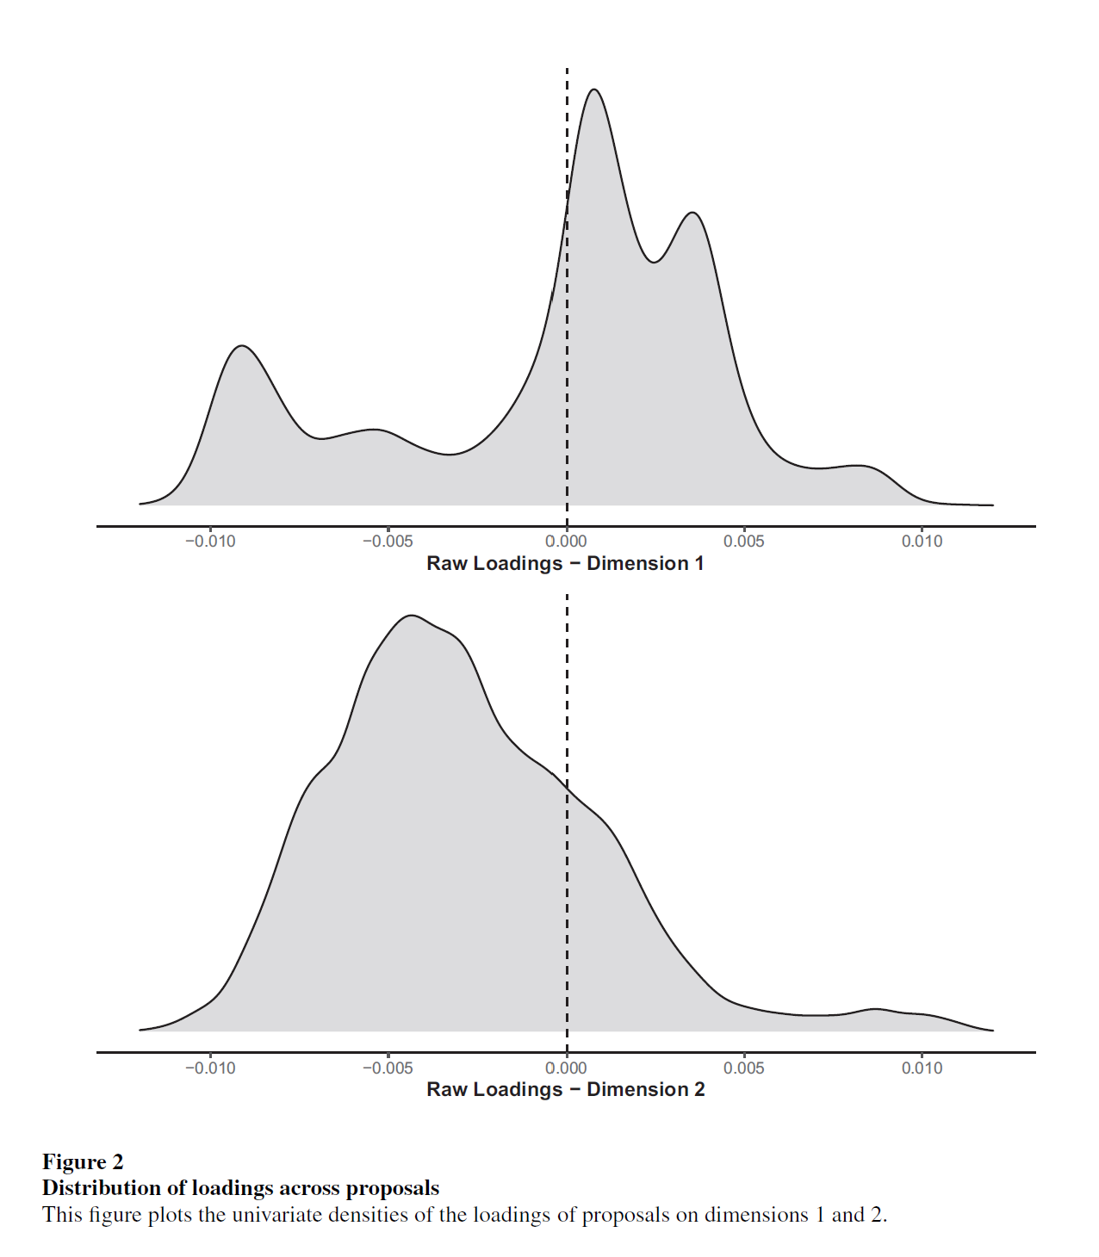
Empirical evidence

Slide 38
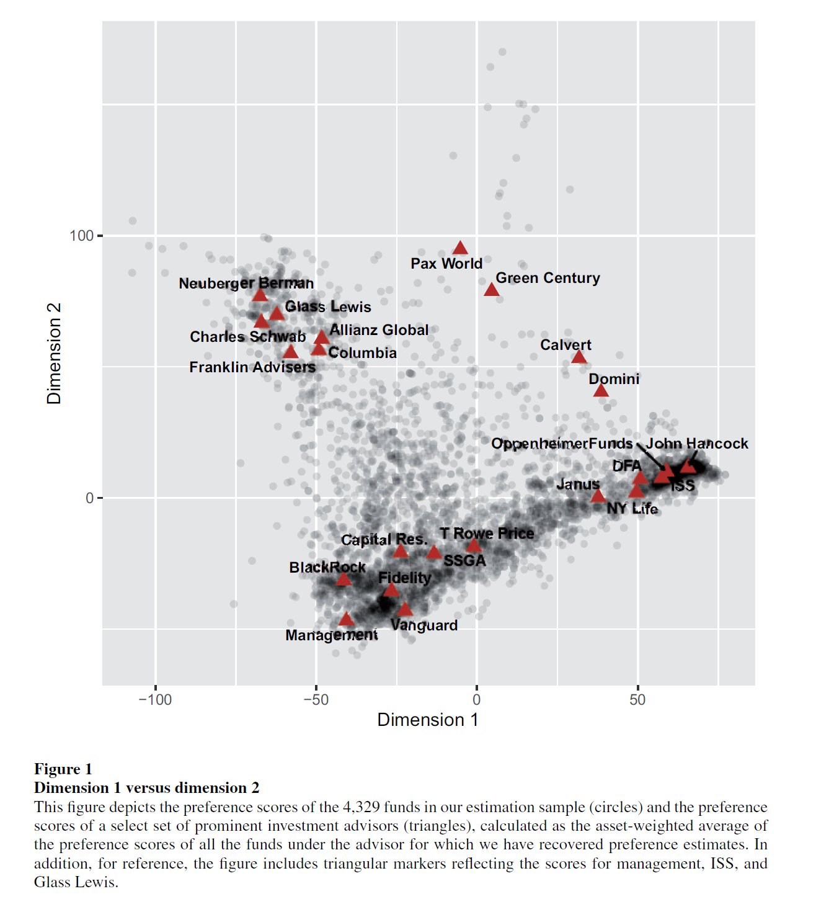
Empirical evidence

Slide 39
Q&A
See you guys on Tue.

